Slide 1
Lindley BESS Project - 100MW/200MWh Stage 1- North West Bend DEVELOPMENT
2024 | Preliminary Information Memorandum
www.synco-global.org

Slide 2
Investment Highlights
Lindley BESS Project 100MW/200MWh

Slide 3
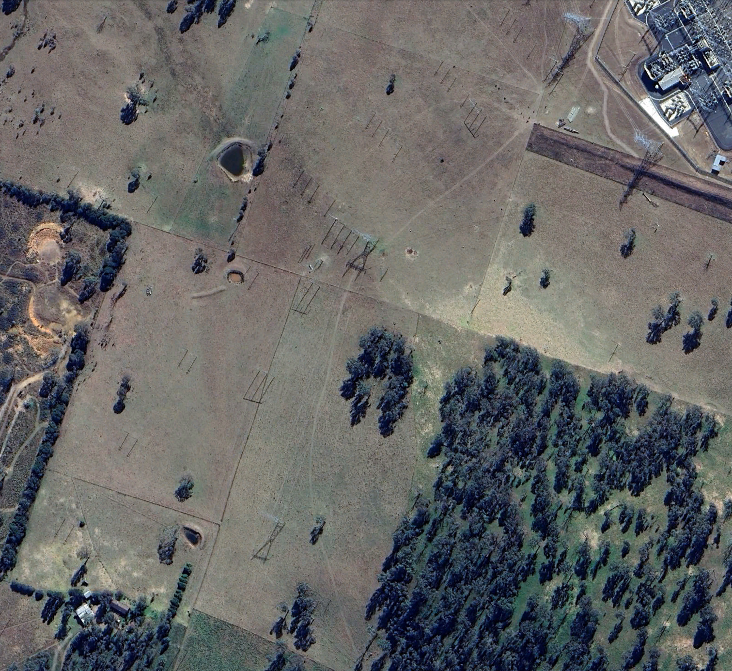
Holloway BESS Project– 400MW/800MWh
Holloway BESS connected to Armidale Terminal, expected RTB in Q4 2025, and COD in H2 2026.
Asset | Location | Located ~500m southwest of Armidale Substation, NSW
 | Technology | Holloway BESS: 400MW / 800MWh BESS - POC 330kV Inverter: Power Electronic Grid Forming PPC: Power Electronic
Advanced Development Stage | Land Secured | land option to purchase. Flat site conditions with easy traffic access.
 | Development Approval | Feasibility study finished. System and Site design finished. Development planning approval in Q2 2025.
 | Connection Agreement | Connection Response Enquiry Issued by Transgrid. GPS Connection study progressing. 534 Letter expected – Q4 2025

Slide 4
Investment Highlights
Critical BESS Infrastructure | As the Australian energy system undergoes rapid transformation, Battery Energy Storage Systems (BESS) will play a crucial role in securing the electricity grid supply. Lindley BESS with its 100MW/200MWh-upwards offers multiple revenue streams across Energy Arbitrage and the Frequency Control Ancillary Service (FCAS) markets. The Connection Application was submitted under the old National Electricity Rules. This allows for a saving of approximately $1m per annum under the System Strength Charge (SSC).
Strategic Location 132kV Grid Connection | Lindley BESS is connected to the 132kV Transmission Line Aurora forecasts MLFs to remain robust between 0.95-1 (Ave 0.98) as more renewables continue to be delivered in the region. High quality of wind and solar resource with on-site water supply.
Stage 1: Advanced Development Status | Lindley BESS development approvals have been secured and 5.3.4A letter of connection approval has been attained. Senior debt is to provide 50-60% of the project financing with 2% margin on top of base rate over a 10-12yr period. SynCo has in-house technical and connection capability to continue supporting the project.
Stage 2 Opportunity | SynCo is flexible to retain ownership or sell the development rights over Stage 2. This process would have no conflict of interest over the operations of Stage 1.
Hydrogen & Other Opportunities | Excess land of 180ha to be retained for further development opportunities. The site is located near a water pipeline which offers a strategic opportunity to develop a green hydrogen hub.
1
2
3
4
5

Slide 5
Project Overview
Lindley BESS Project 100MW/200MWh

Slide 6
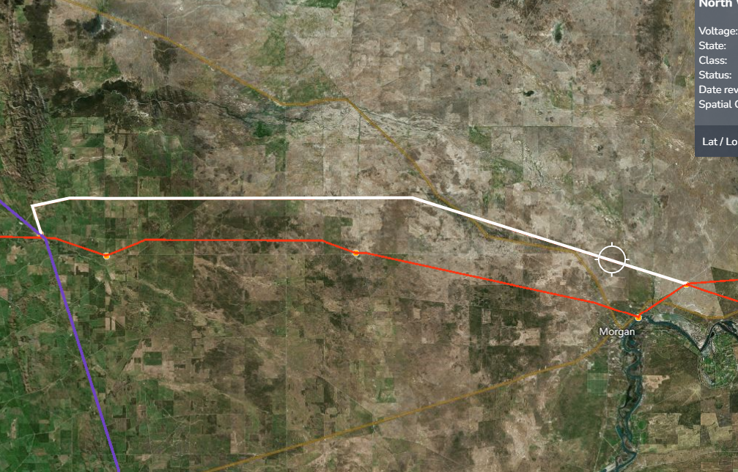
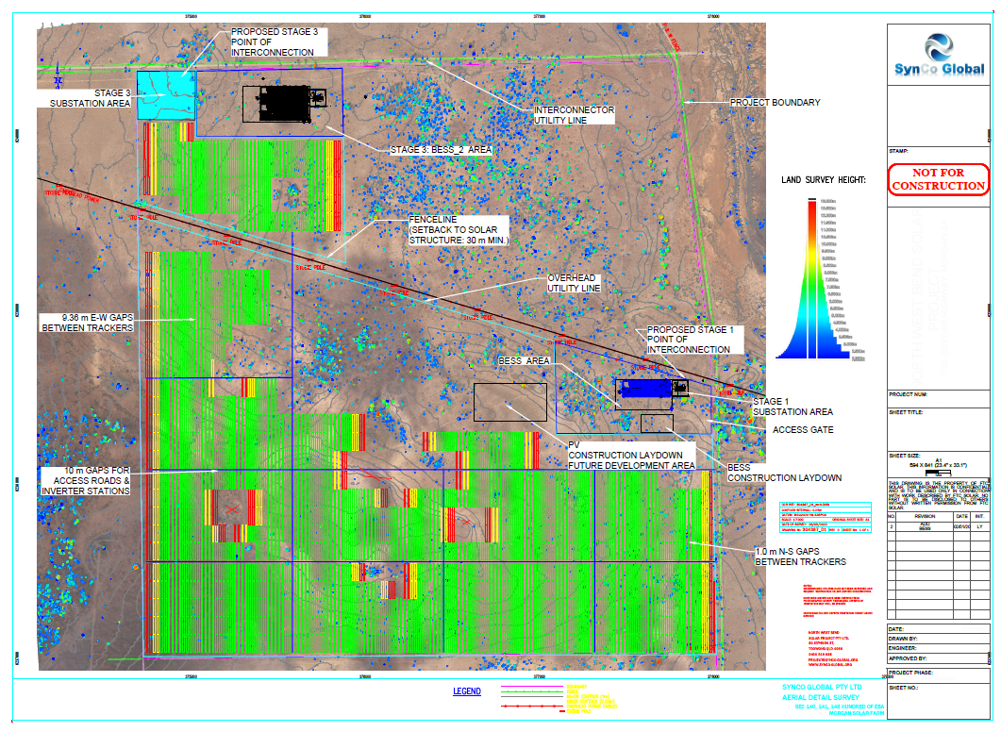
Project location Overview
North-West Bend Development - Lindley BESS Project
2GW+ PIPELINE
NORTH-WEST BEND DEVELOPMENT
1-2GW Project Pipeline
132kV Tx
LINDLEY BESS PROJECT
Robertstown Substation
North-West Bend Substation
6

Slide 7
NORTH WEST BEND DEVELOPMENT – 2 PROJECTS
Lindley BESS offers focused investors an advanced development asset at a ready to build phase.
Asset | Location | Located ~130km northeast of Adelaide, South Australia.
 | Technology | Stage 1 Lindley BESS: 100MW / 200MWh-400MWh+ BESS - 132kV Stage 2 Brenda Energy Park: 260MW Solar & 200MW/400MWh+ BESS - 330kV Future Opportunities: Hydrogen (nearby water pipeline) Wind: 7.6m/s @ 150m height
Advanced Development Stage | Land Secured | 550ha of freehold land covering all stages of the development. Flat site conditions with easy traffic access. SynCo is flexible to a land sale or long-term lease with the investors.
 | Development Approval | SA State Gov the Office of the Technical Regulator (OTR) Certificate issued in Oct 2023. Development planning approval secured in Q3 2023.
 | Connection Agreement | Stage 1 connection offer & 5.3.4A letter in Q4 2023. Substation detailed design has been finalised
Key Metrics – Stage One | Construction Period | 12-18 months
 | Commercial Operations Date | 6 weeks from completion of construction
 | Secured Senior Debt Financing | InfraDebt – 50% gearing ratio
 | Project IRR | [18.0]% (pre-tax) / [15.3]% (post-tax)
 | Equity IRR | [24.0]% (pre-tax) / [20.2]% (post-tax)
 | Equity Payback Period | Approximately 5 years
 | Est Revenue | A$21.6m (Year 1) Market revenue forecasts by Aurora Energy
 | Asset Life | 30 years (re-powering in Year 14)

Slide 8
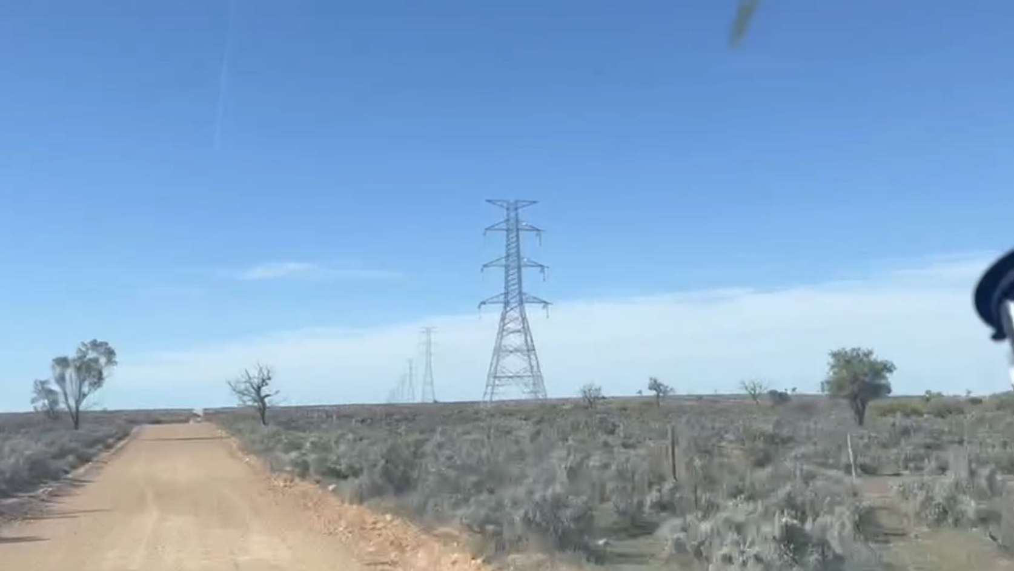
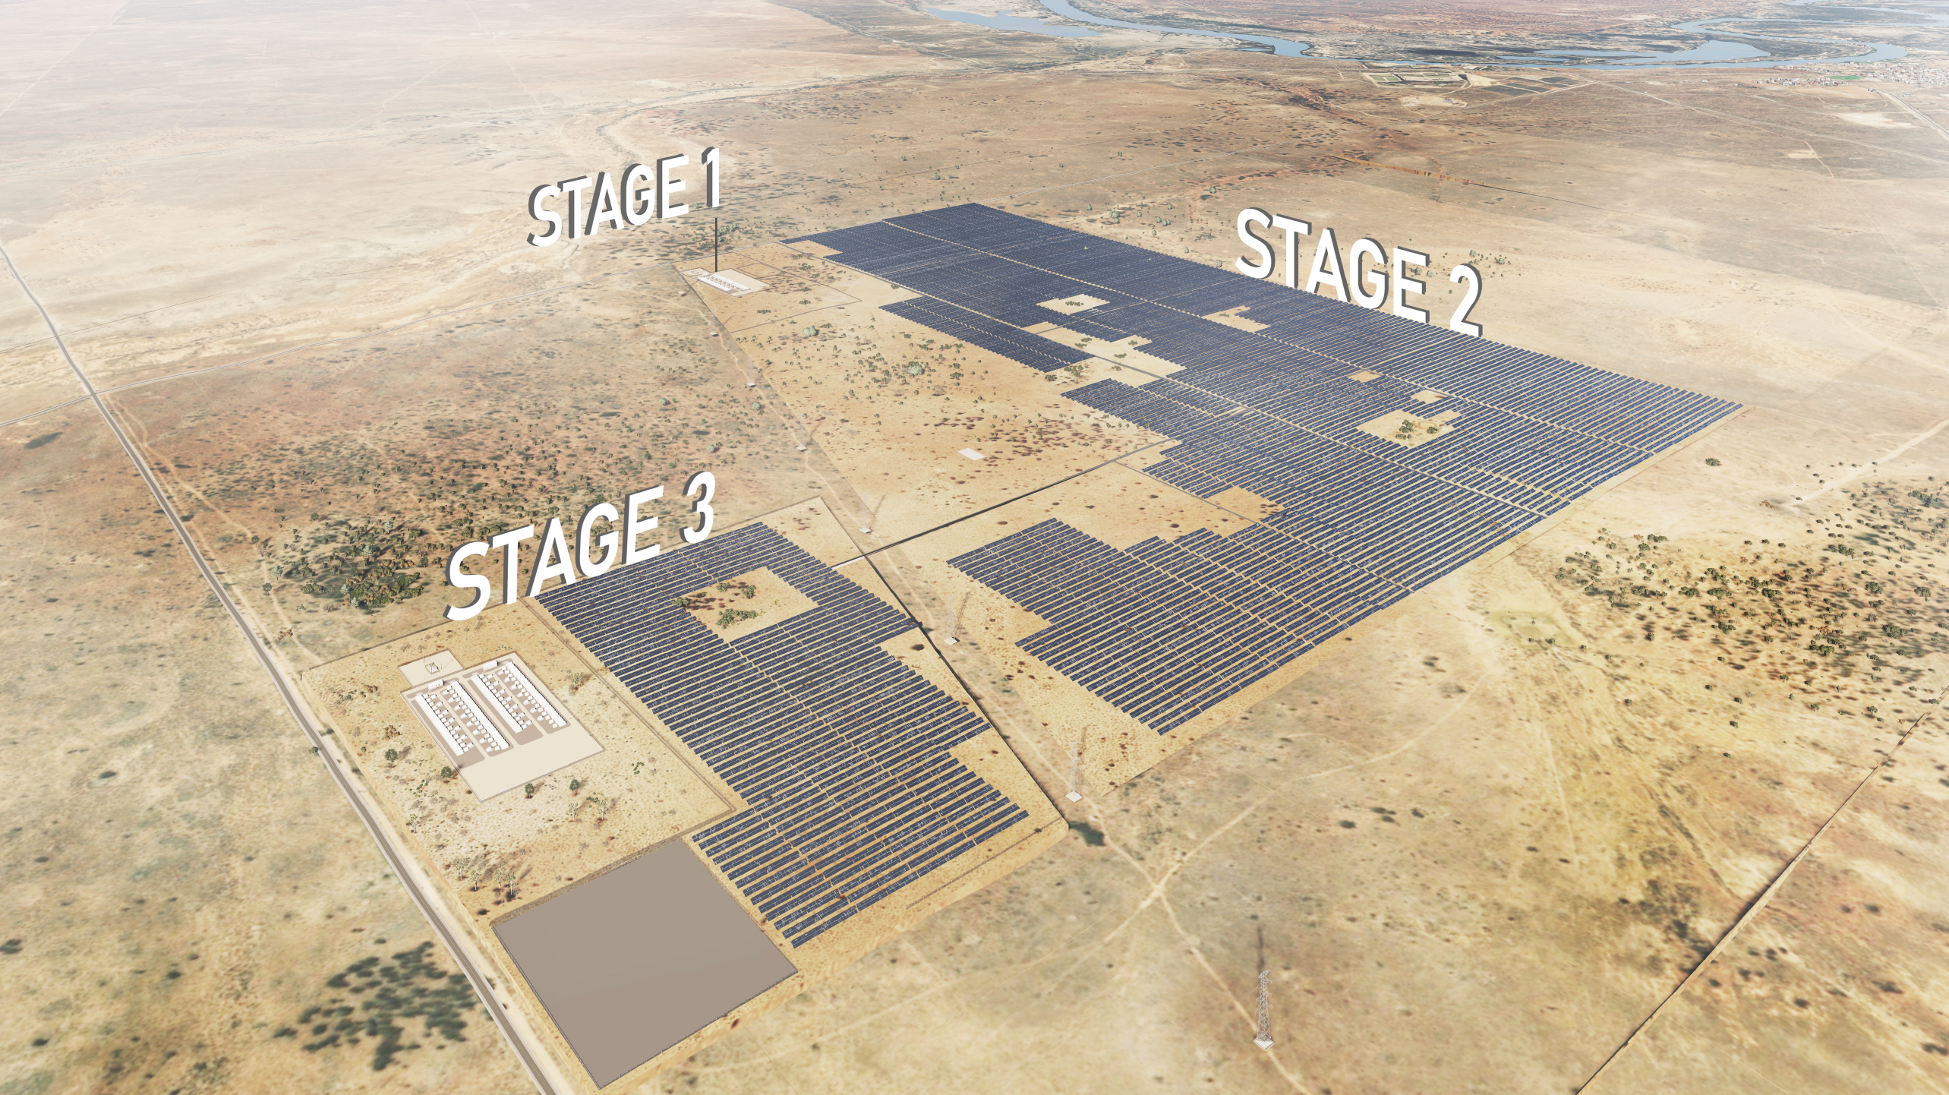
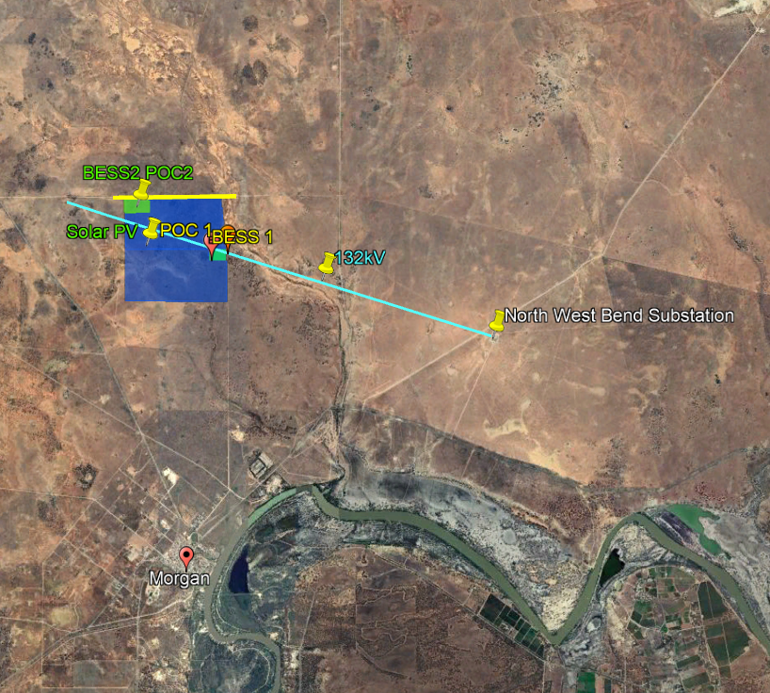
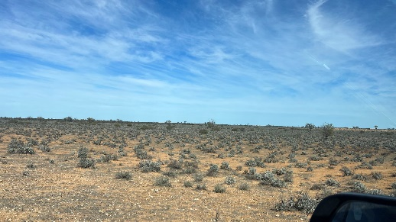
Lindley BESS – Flexible energy footprint
Lindley BESS Project – Future Opportunities.
SynCo is planning to develop a shared substation for Stage 2, which allows other projects to connect.
Future upgrade to Wind or Green Hydrogen project.
New Inter-Connector from SA to NSW Project of EnergyConnect run along the perimeter of the project site.
Hydrogen
Potential
132kV
2
Hydrogen
Potential
Hydrogen
Potential
330kV Interconnector
Water
Pipeline
shared substation

Slide 9
Lindley BESS DELIVERY STRUCTURE
The project has both offshore and local direct structures. We have an Australian local trust and a Singapore VCC sub-fund, each independently holding 100% ownership. The delivery structure is flexible.
Shareholders
PARTNER
Singapore Fund
or
Synlab Trust
SynCo SPVs - 100% Australian Family Trust
Lindley SG SPV – 100% VCC fund in Singapore
Shareholder’s Agreement
Majority %
Minority %
Joint Venture
SynCo Global Pty Ltd
SPV
Lindley Project Pte Ltd (SG)
North West Bend Solar Project Pty Ltd (AU)
Merchant Market
or
Contracted Market
Services Agreement
PARTNER
Key Project Commitments
SynCo Investment Pty Ltd
Lenders
Early Work Contractor
Offtaker*
ElectraNet
Split - EPCI Contractors
O&M Contractor
Land Lease Agreement
Finance Agreement
Early Works Agreement
Auto-bidding Service
Or Power Purchase Agreement
Transmission Connection Agreement
BoP - EPCI Agreement
O&M Agreement
*Partner/CIS dependent

Slide 10
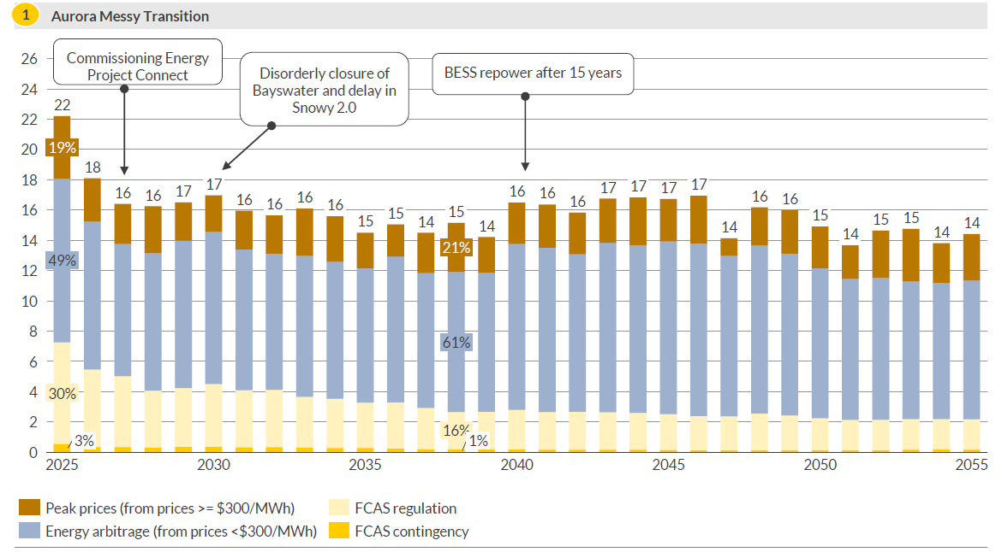
Lindley Bess Gross Margins forecast
Lindley BESS annual gross margin peaks at ~$22m within the first four years and averages at ~$15.8m throughout its term.
Annual gross margins ($million Aud) as of 2022
Gross margins peak at ~$ 22m in the earlier years of operation with ancillary market participation contributing to 33% of revenues.
In Aurora Messy Transition, Lindley BESS is forecasted to achieve an annual average gross margin of $15.8m throughout its term.
Source: Aurora Energy Research

Slide 11
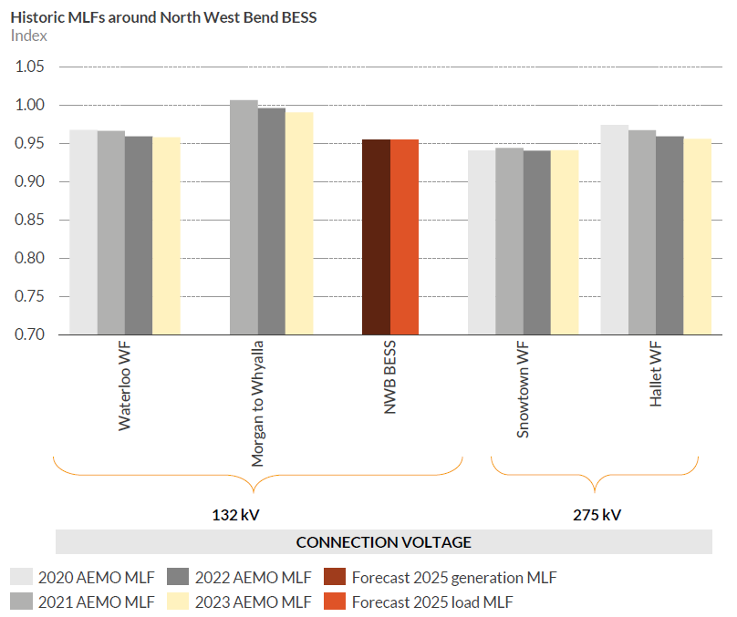
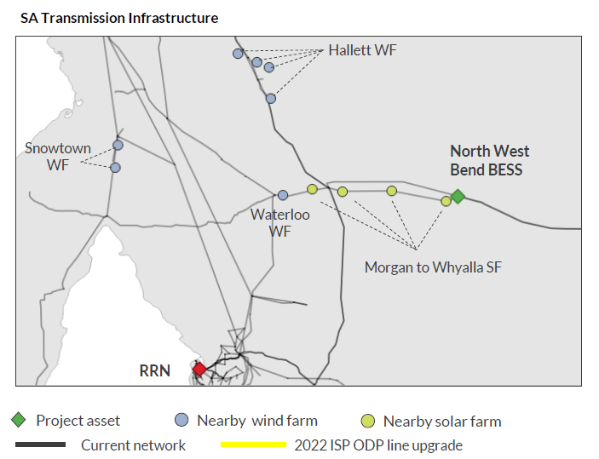
LINDLEY BESS Grid & MLF
Aurora forecasts generation MLFs for the Lindley BESS are expected to Ave. 0.98 and to remain in the 0.95-1 range over the forecast horizon, while load MLFs are expected to stay between 0.90-0.98 as more renewable capacity continue to be delivered in the region.
Source: Aurora Energy Research, Australian Energy Market Operator (AEMO)

Slide 12
LINDLEY BESS Development Timeline
Development & Connection Approvals R0 phase
2020 - Early 2022
SA State Government Development OTR Issued
Application Submission
March 2023
Authorities Site Visit
State Department for Environment & Water
State Department for Energy & Mining
Jul 2023
DA Planning Issued
FIA processing
Dec 2023
5.3.4A Letter
Dec 2023
DA all phases
ElectraNet Early work design
R1 Phase
Q4 2024
NTP Construction
Q4 2025
Commissioning & Hold Point Testing
Operation → 2054
Q1 2024
EPC Negotiations
ElectraNet Transmission Connection Agreement Negociation

Slide 13
Disclaimer
By retaining a copy of this confidential Information Memorandum, the recipient is deemed to have accepted the terms of this Disclaimer and to have undertaken to the Company that it will not act on a basis inconsistent with it.
The information contained in this Information Memorandum is confidential and commercially sensitive. The information is provided solely for use by parties interested in evaluating whether to acquire the project and may not be used for any other purpose, nor disclosed to any person, except with the prior written consent of SynCo (the Company) or in accordance with a duly signed non-disclosure agreement.
The information does not purport to be complete or contain all the information that a prospective investor may require. It is not intended to be relied upon as advice and does not take into account the investment objectives, financial situation or needs of any particular party. The recipient agrees that it will be making an independent assessment of the information and that the recipient will determine for itself what further enquiries are required.
This Information Memorandum contains forward-looking statements, which are not guarantees of future performance and involve known and unknown risks, uncertainties and other factors, which are beyond the control of the Company.
Any statements about past performance are not necessarily indicative of future performance. The information contained or referred to in this confidential Information Memorandum does not and will not form the basis of any contract with the recipient. Any formal contract(s) for the purposes of effecting any investment (whether direct or indirect) of the project will expressly contain any and all information, representations and warranties upon which there may be any reliance by a third party.
The recipient acknowledges that it is not entitled t o rely upon the information contained in this Information Memorandum in any way. This document does not constitute an offer, invitation, solicitation, advice or recommendation with respect to the issue, purchase, or sale of any securities or other financial products.
The distribution of this confidential Information Memorandum in jurisdictions outside of Australia may be restricted by law and persons who come into possession of this Information Memorandum should seek advice on and observe any such restrictions. Any failure to comply with such restrictions may constitute a violation of applicable securities laws.
By retaining a copy of this confidential Information Memorandum, the recipient is deemed to have accepted the terms of this Disclaimer and to have undertaken to the Company that it will not act on a basis inconsistent with it. If the recipient does not accept the terms of this Disclaimer, it must delete all copies of this confidential Information Memorandum immediately after its receipt.

Slide 14
Contact
2GW+ development pipeline across the NEM.
lynne.yu@synco-global.org +61 400 519 698
www.synco-global.org

